Slide 1
3rd Chapter Scan Conversion
CMP 477 Computer Graphics
S. A. Arekete

Slide 2
What is Scan-Conversion?
🠶 2D or 3D objects in real world space are made up of graphic primitives such as points, lines, circles and filled polygons.
🠶 These picture components are often defined in a contiguous space at a higher level of abstraction than individual pixels in the discrete image space.
🠶 For instance, a line is defined by its two endpoints and the line equation while a circle is defined by its radius, centre position, and the circle equation.
🠶 It is the responsibility of the graphics system or the application program to convert each primitive from its geometric definition into a set of pixels that makes up the primitive in the image space.
🠶 This conversion task is generally referred to as scan-conversion or rasterization.

Slide 3
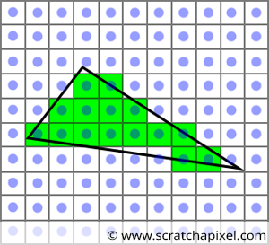
Scan conversion/ Rasterization

Slide 4
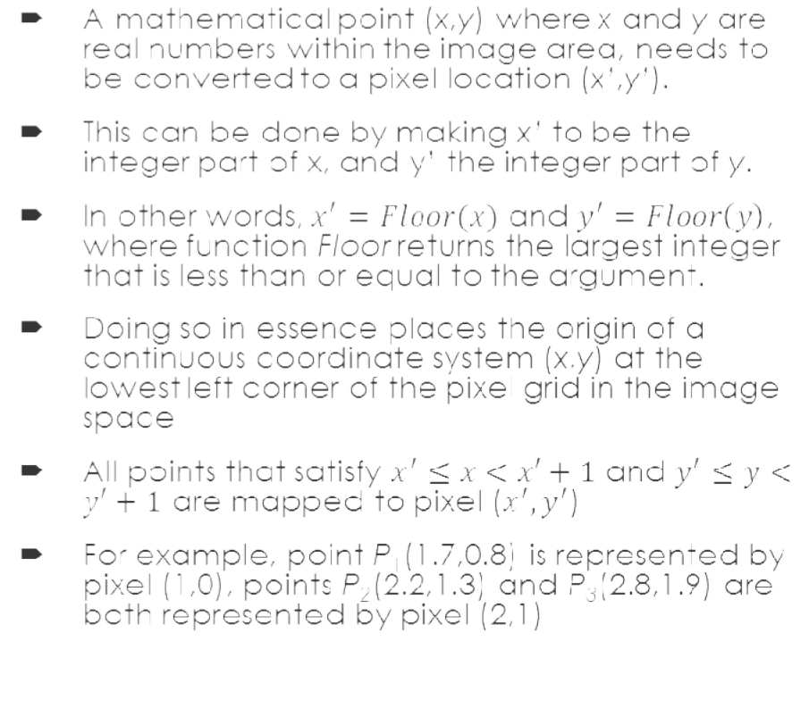
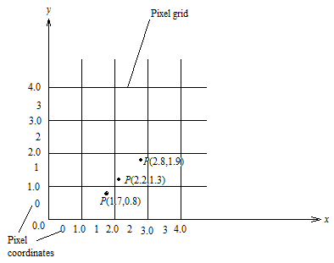
Scan-Converting a Point

Slide 5
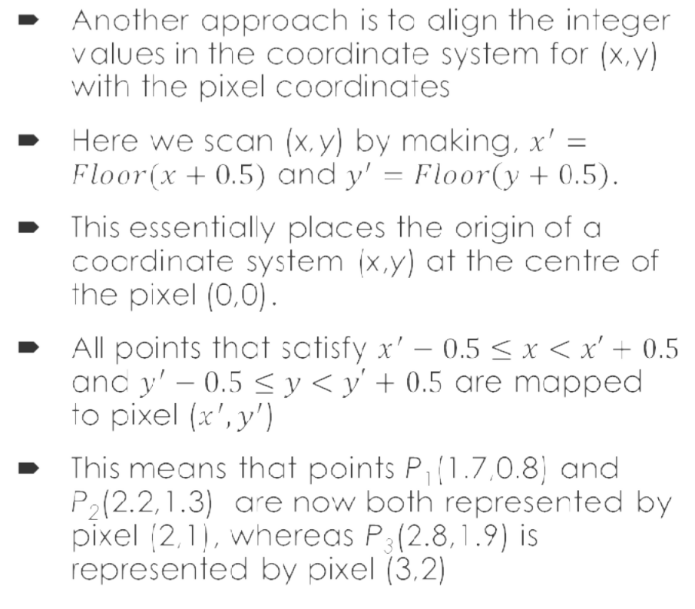
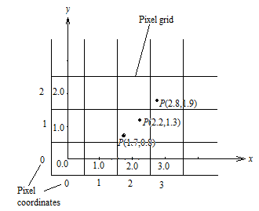
Scan-Converting a Point

Slide 6
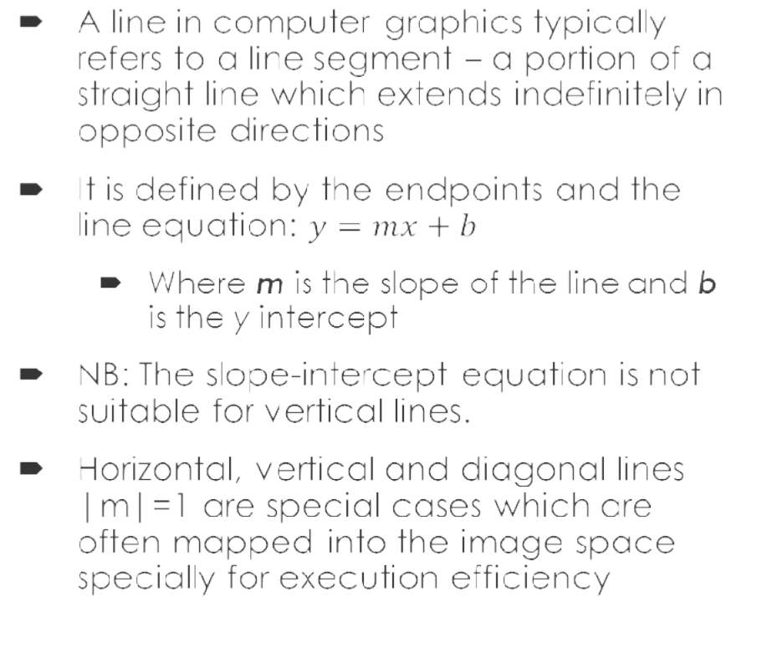
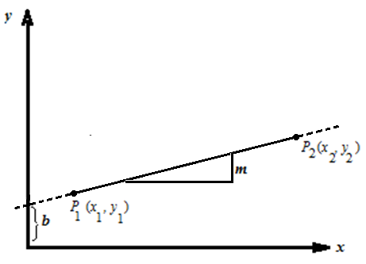
Scan-Converting a Line

Slide 7
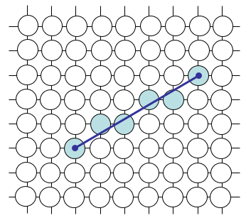
Consideration for Scan-Conversion of a Line
🠶 But what happens when we try to draw line on a pixel based display?
🠶 How do we choose which pixels
to turn on?
🠶 The line has to look good
🠶 Avoid jaggies
🠶 The drawing has to be very fast!
🠶 How many lines need to be drawn in a typical scene?
🠶 This is going to come back to bite us again and again

Slide 8
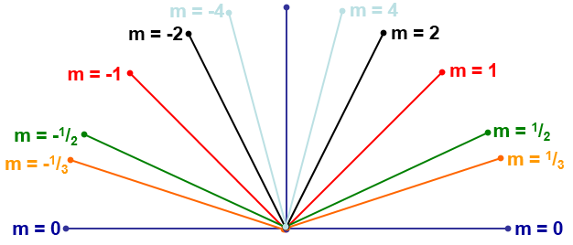
Lines and Slopes
🠶 The slope of a line (m) is defined by its start and end coordinates
🠶 The diagram below shows some examples of lines and their slopes

Slide 9
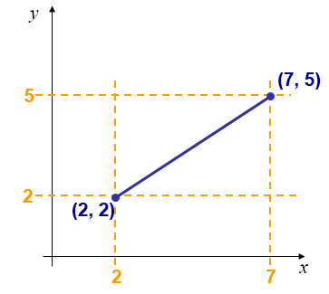
An Example of Direct Line Equation Method
🠶 We could simply work out the corresponding y coordinate for each unit x coordinate
🠶 Let’s consider the following example:

Slide 10
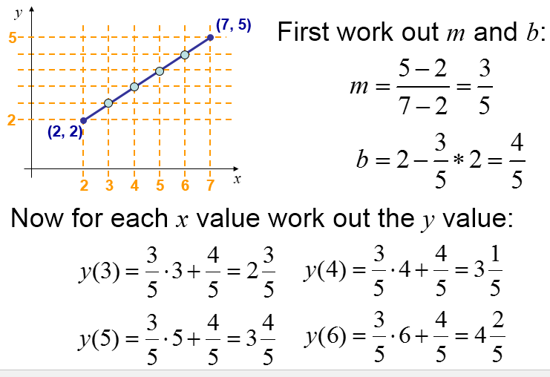
Direct Line Equation Method..

Slide 11
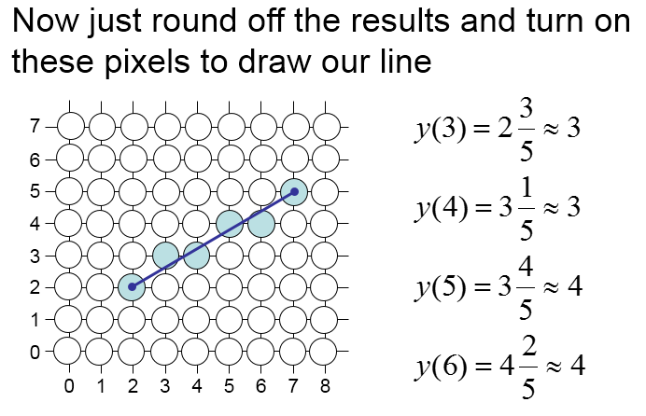
Direct Line Equation Method..

Slide 12
Limitations of the Direct Line Equation Method
🠶 However, this approach is just way too slow as mentioned earlier
🠶 In particular look out for:
🠶 The equation y = mx + b requires the multiplication of m by x
🠶 Rounding off the resulting y coordinates
🠶 We need a faster solution

Slide 13
The DDA Algorithm..
🠶 The digital differential analyzer (DDA) algorithm takes an incremental approach in order to speed up scan conversion
🠶 Simply calculate y_{k+1} based on y_{k}
🠶 Consider the list of points that we determined for the line in our previous example:
🠶 (2, 2), (3, 2³/₅), (4, 3¹/₅), (5, 3⁴/₅), (6, 4²/₅), (7, 5)
🠶 Notice that as the x coordinates go up by one, the y coordinates simply go
up by the slope of the line
🠶 This is the key insight in the DDA algorithm

Slide 14
The DDA Algorithm..
🠶 When the slope of the line is between -1 and 1 begin at the first point in the line and, by incrementing the x coordinate by 1, calculate the corresponding y coordinates as follows:
^{y}k +1 ^{= y}k
+ m
🠶 When the slope is outside these limits, increment the y coordinate by 1 and calculate the corresponding x coordinates as follows:
₊ 1
m
x = x
k +1
k
🠶 Limitation of the DDA: The values calculated by the equations used by the DDA algorithm must be rounded to match pixel values

Slide 15
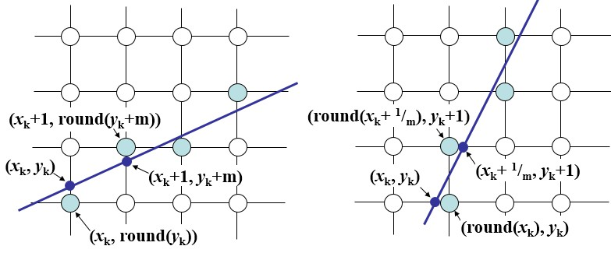
The DDA Algorithm..

Slide 16
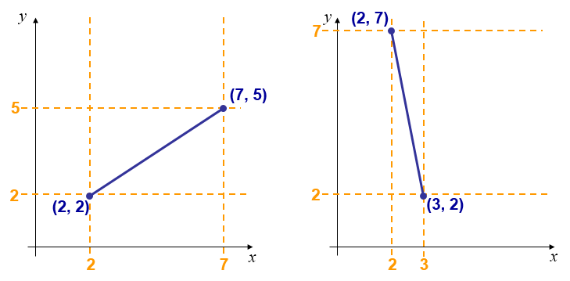
DDA Algorithm Example
🠶 Let’s try out the following examples:

Slide 17
The DDA Algorithm Summary
🠶 The DDA algorithm is much faster than our previous attempt
🠶 In particular, there are no longer any multiplications involved
🠶 However, there are still two big issues:
🠶 Accumulation of round-off errors can make the pixelated line drift away from what was intended
🠶 The rounding operations and floating point arithmetic involved are time
consuming

Slide 18
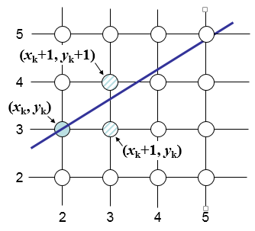
The Bresenham’s Line Algorithm
🠶 The Bresenham algorithm is another incremental scan conversion algorithm
🠶 The big advantage of this algorithm is that it uses only integer calculations
🠶 Move across the x axis in unit intervals and
at each step choose between two different y coordinates
🠶 For example, from position (2, 3) we have to choose between (3, 3) and (3, 4)
🠶 We would like the point that is closer to the original line

Slide 19
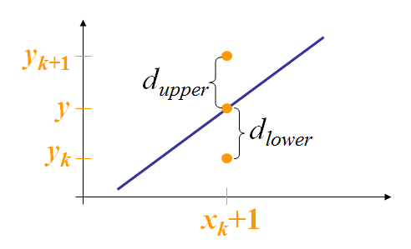
The Bresenham’s Line Algorithm..
🠶 At sample position x_{k}+1 the vertical separations from the mathematical line are labelled d_{upper} and d_{lower}
🠶 The y coordinate on the mathematical line at x_{k}+1 is:
y = m(x_{k} +1) + b

Slide 20
The Bresenham’s Line Algorithm..
🠶 So, d_{upper} and d_{lower} are given as follows:
^{d}lower
= y − y_{k}
= m(x_{k} +1) + b − y_{k}
🠶 and
^{d}upper ^{= ( y}k
+1) − y
= y_{k} +1− m(x_{k} +1) − b
🠶 We can use these to make a simple decision about which pixel is closer to the mathematical line

Slide 21
The Bresenham’s Line Algorithm..
🠶 This simple decision is based on the difference between the two pixel positions:
^{d}lower
− d_{upper} = 2m(x_{k} +1) − 2 y_{k} + 2b −1
🠶 Let’s substitute m with ∆y/∆x where ∆x and ∆y are the differences between the end-points:
Δx(d − d
) = Δx(2 ^{Δy} (x +1) − 2 y + 2b −1)
lower
upper
Δx
k k
= 2Δy ⋅ x_{k} − 2Δx ⋅ y_{k} + 2Δy + Δx(2b −1)
= 2Δy ⋅ x_{k} − 2Δx ⋅ y_{k} + c

Slide 22
The Bresenham’s Line Algorithm..
🠶 So, a decision parameter p_{k} for the kth step along a line is given by:
p_{k} = Δx(d_{lower}
^{− d}upper ⁾
= 2Δy ⋅ x_{k} − 2Δx ⋅ y_{k} + c
🠶 The sign of the decision parameter p_{k} is the same as that of d_{lower} – d_{upper}
🠶 If p_{k} is negative, then we choose the lower pixel, otherwise we choose the
upper pixel

Slide 23
The Bresenham’s Line Algorithm..
🠶 Remember coordinate changes occur along the x axis in unit steps so we can do everything with integer calculations
🠶 At step k+1 the decision parameter is given as:
p_{k +1} = 2Δy ⋅ x_{k +1} − 2Δx ⋅ y_{k +1} + c
🠶 Subtracting p_{k} from this we get:
^{p}k +1 ^{− p}k
= 2Δy(x_{k +1} − x_{k} ) − 2Δx( y_{k +1} − y_{k} )

Slide 24
The Bresenham’s Line Algorithm..
But, x_{k+1} is the same as x_{k}+1 so:
^{p}k +1 ^{= p}k
+ 2Δy − 2Δx( y_{k +1} − y_{k} )
where y_{k+1} - y_{k} is either 0 or 1 depending on the sign of p_{k}
The first decision parameter p₀ is evaluated at (x₀, y₀) is given as:
p₀ = 2Δy − Δx

Slide 25
BRESENHAM’S LINE DRAWING ALGORITHM
(for |m| < 1.0)
Input the two line end-points, storing the left end-point in (x₀, y₀)
Plot the point (x₀, y₀)
Calculate the constants Δx, Δy, 2Δy, and (2Δy - 2Δx) and get the first value for the decision parameter as: p₀ = 2Δy − Δx
At each x_{k} along the line, starting at k = 0, perform the following test. If p_{k} <
0, the next point to plot is (x_{k}+1, y_{k}) and:
^{p}k +1 ^{= p}k
+ 2Δy
Otherwise, the next point to plot is (x_{k}+1, y_{k}+1) and: ^{p}k +1 ^{= p}k
+ 2Δy − 2Δx
5. Repeat step 4 (Δx – 1) times
N.B.: The algorithm and derivation above assumes slopes are less than 1. For other slopes we need to adjust the algorithm slightly

Slide 26
An Example on Bresenham’s Line Algorithm
🠶 Let’s have a go at this:
🠶 Let’s plot the line from (20, 10) to (30, 18)
🠶 First off calculate all of the constants:
Δx: 10
Δy: 8
2Δy: 16
2Δy - 2Δx: -4
🠶 Calculate the initial decision parameter p₀:
p₀ = 2Δy – Δx = 6

Slide 27
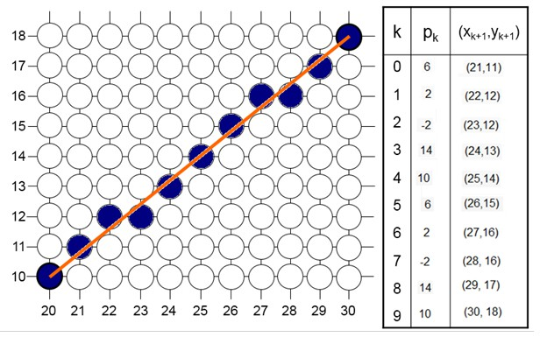
An Example on Bresenham’s Line Algorithm..
🠶 Go through the steps of the Bresenham line drawing algorithm for a line going from (21,12) to (29,16)

Slide 28
Bresenham Line Algorithm Summary
🠶 The Bresenham’s line algorithm has the following advantages:
🠶 A fast incremental algorithm
🠶 Uses only integer calculations
🠶 Comparing this to the DDA algorithm, DDA has the following problems:
🠶 Accumulation of round-off errors can make the pixelated line drift away from what was intended
🠶 The rounding operations and floating point arithmetic involved are time
consuming

